Slide 1
Trends in international assessents
Moscow
14 April 2017
Andreas Schleicher
Notes:
I want to start with a brief overview of the objectives and origins of PISA, then show you where the US stands and what the most effective school systems show can be achieved, and conclude with what all of this means for education policy.
I need to remind you that the material remains under embargo until next Tuesday.

Slide 2
OECD instruments
Student assessment
How? Methods and procedures, mix of criteria and instruments
Mapping of feedback to different units
Classroom
Teacher appraisal
For what? E.g.
Accountability
Improvement
Who is assessed
School
School evaluation
System
System assessment
Notes:
The approaches to assessment that countries are pursuing to get there differ markedly.
Many systems seek to figure out how effectively education systems, or parts of them, function as a whole. To do that, they typically assess a sample of schools and students rather than every student in every school. Of course, you then cannot compare the performance of individual schools and build accountability systems around that. On the other hand, you can put more resources into testing fewer students better, rather than sacrifacing validity gains for efficiency gains.
Other assessment systems focus on school performance. And yet others seek evaluate teachers and students in classrooms.
And of course, all of these systems are complementary and they typically look at what students are able to do.
Assessment systems, and the philosophies around which they are build, vary also by their purposes. Is the primary purpose accountability, are results made publicly available and linked to some form of consequencies? Those purposes are common in England, the United States and Latin America.
Or is the focus diagnosis and improvement, with the results feeding back directly to teachers and learners? Again, these are complementary not competing objectives, even if there is some tension between objectivity in an assessment and relevance. That tends to be the primary focus in Northern Europe or Scotland, for example.
There are also differences with who is in charge to prepare the evaluation, to conduct it and to use the results.
Systems involve very different actors and stakeholders in their assessment processes, often this is related to the political economy to maximise the utilisity and acceptance of assessment processes.
Similarly, the type of instruments, differ widely, both within but also across countries. When you think about an assessment in the United States, you may imagine a multiple-choice test, but there are other countries where multiple-choice tests are not used at all, they may use open-ended assessments or even oral examinations. Or they may use classroom observations, student or teacher portfolios or other instruments. I will come back to this aspect.
And then, of course, assessments differ by what they assess, whether the focus is on inputs, processes or outputs.

Slide 3
The ‘big’ trends
Multi-layered, coherent assessment systems from classrooms to schools to regional to national to international levels that…
  Support improvement of learning at all levels of the education system
  Are largely performance-based
  Make students’ thinking visible and allow for divergent thinking
  Are adaptable and responsive to new developments
  Add value for teaching and learning by providing information that can be acted on by students, teachers, and administrators Are part of a comprehensive and well-aligned continuum, communicate what is expected and hold relevant stakeholders accountable .
Notes:
But there are also some common trends, most importantly the move towards multi-layered assessment systems that coherently extend from students to schools to states, nations and the international level.
These assessments seek not to take learning time away from students, but try to enhance the learning of students, of teachers, of school administrators and policy makers, through building frameworks for lateral accountability.
The assessments underline that successful learning is as much about the process as it is about facts and figures, they emphasise that success is not about the reproduction of subject matter content, but about the capacity to integrate, synthesize and creatively extrapolate from what you know and apply that knowledge in novel situations.
They try to provide a window into students’ understandings and the conceptual strategies a student uses to solve a problem.
They provide dynamic task contexts in which prior actions may stimulate unpredictable reactions that in turn influence subsequent strategies and options.
They try to add value for teaching and learning. The process of responding to assessments can
enhance student learning if assessment tasks are well crafted to incorporate principles of learning and cognition. For example, assessment tasks can incorporate transfer and authentic applications, and can provide opportunities for students to organize and deepen their understanding through explanation and use of multiple representations. They try to generate information that can be acted upon and provides productive and usable feedback for all intended users. Teachers need to be able to understand what the
assessment reveals about students’ thinking. And school administrators, policymakers, and teachers need to be able to use this assessment information to determine how to create better opportunities for student learning.
Last but not least, those assessments do not operate in a vacuum but, are part of a comprehensive set of instruments that extend to instructional material as well as teacher training.

Slide 4
Some criteria
Coherence
  Built on a well-structured conceptual base—an expected learning progression—as the foundation both for large scale and classroom assessments
  Consistency and complementarity across administrative levels of the system and across grades
Comprehensiveness
  Using a range of assessment methods to ensure adequate measurement of intended constructs and measures of different grain size to serve different decision-making needs
  Provide productive feedback, at appropriate levels of detail, to fuel accountability and improvement decisions at multiple levels
Continuity
  A continuous stream of evidence that tracks progress .

Slide 5
Measuring learning outcomes at school
PISA

Slide 6
PISA 2015
OECD
Partners

Slide 7


Recognise, offer and evaluate explanations for a range of natural and technological phenomena.
Describe and appraise scientific investigations and propose ways of addressing questions scientifically.
Analyse and evaluate data, claims and arguments in a variety of representations and draw appropriate scientific conclusions.
        Competencies
        Explain phenomena scientifically
        Evaluate and design scientific enquiry
        Interpret data and evidence scientifically
Notes:
Let me show you another example from PISA here. This is how we defined science

Slide 8
Each of the scientific competencies requires content knowledge (knowledge of theories, explanatory ideas, information and facts), but also an understanding of how such knowledge has been derived (procedural knowledge) and of the nature of that knowledge (epistemic knowledge)
“Epistemic knowledge” reflects students’ capacity to think like a scientist and distinguish between observations, facts, hypotheses, models and theories
        Competencies
        Explain phenomena scientifically
        Evaluate and design scientific enquiry
        Interpret data and evidence scientifically
        Knowledge
        Content knowledge
        Knowledge of methodological procedures used in science
        Knowledge of the epistemic reasons and ideas used by scientists to justify their claims
Notes:
Let me show you another example from PISA here. This is how we defined science

Slide 9
Peoples’ attitudes and beliefs play a significant role in their interest, attention and response to science and technology.
PISA distinguishes between attitudes towards science (e.g. interest in different content areas of science) and scientific attitudes (e.g. whether students value scientific approaches to enquiry)
        Competencies
        Explain phenomena scientifically
        Evaluate and design scientific enquiry
        Interpret data and evidence scientifically
        Knowledge
        Content knowledge
        Knowledge of methodological procedures used in science
        Knowledge of the epistemic reasons and ideas used by scientists to justify their claims
        Attitudes
        Attitudes to science
        Scientific attitudes
Notes:
Let me show you another example from PISA here. This is how we defined science

Slide 10
        Context
Personal, local/national and global issues, both current and historical, which demand some understanding of science and technology
        Personal, local, global
        Current and historical
        Competencies
        Explain phenomena scientifically
        Evaluate and design scientific enquiry
        Interpret data and evidence scientifically
        Knowledge
        Content knowledge
        Knowledge of methodological procedures used in science
        Knowledge of the epistemic reasons and ideas used by scientists to justify their claims
        Attitudes
        Attitudes to science
        Scientific attitudes
Notes:
Let me show you another example from PISA here. This is how we defined science

Slide 11
Measuring learning outcomes at school
Broadening learning outcomes

Slide 12
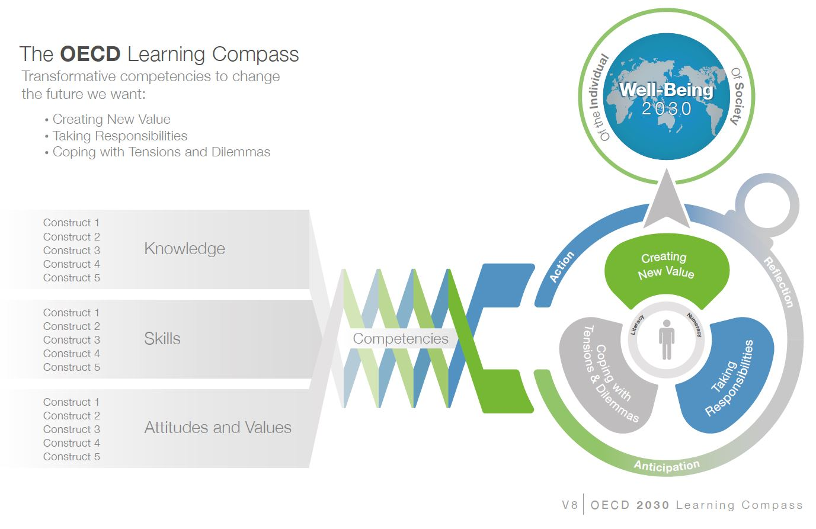
OECD Learning Framework 2030

Slide 13
PISA
2012: Financial literacy
2015: Social skills
  Collaborative problem-solving
2018: Global competency
  Skills, knowledge, understanding
2021: Creative thinking
PISA for schools

Slide 14
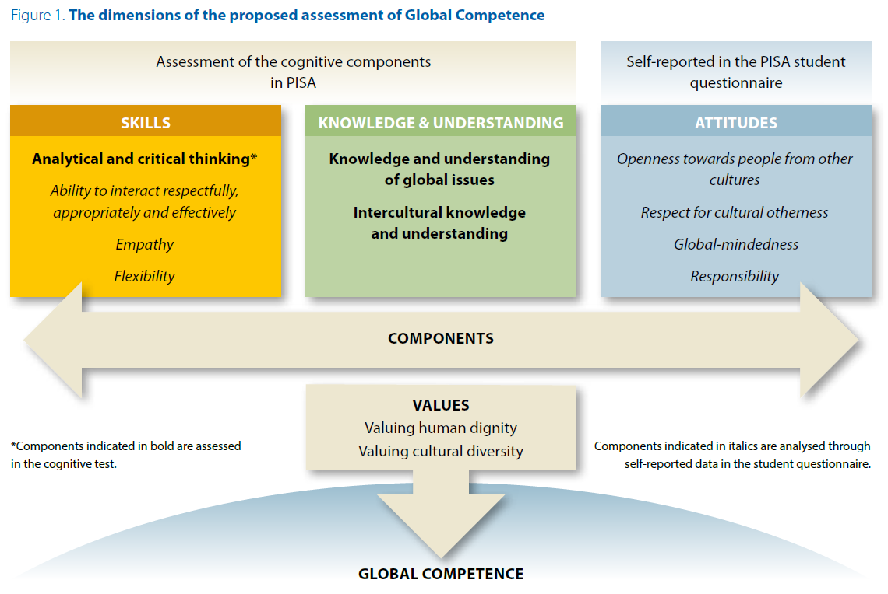
Global competency in PISA

Slide 15
Measuring learning outcomes at school
Understanding learning strategies

Slide 16
Memorisation is less useful as problems become more difficult (OECD average)
Odds ratio
Greater success
Easy problem
Memorisation is associated with a lower chance of success as problems become more difficult
Difficult problem
Less success
Source: Figure 4.3
Notes:
Notes: Statistically significant odds ratios are marked in a darker tone.
Chile and Mexico are not included in the OECD average.
Odds ratio are calculated across 48 education systems.

Slide 17
Control strategies are always helpful but less so as problems become more difficult (OECD average)
Odds ratio
Greater success
Using control strategies is associated with a lower chance of success as problems become more difficult
Easy problem
Difficult problem
Less success
Source: Figure 5.2
Notes:
Notes: Statistically significant odds ratios are marked in a darker tone. Chile and Mexico are not included in the OECD average.
Odds ration are calculated across 48 education systems.

Slide 18
Elaboration strategies are more useful as problems become more difficult (OECD average)
Odds ratio
Greater success
Using elaboration strategies is associated with a greater chance of success as problems become more difficult
Difficult problem
Easy problem
Less success
Source: Figure 6.2
Notes:
Notes: Statistically significant odds ratios are marked in a darker tone. Chile and Mexico are not included in the OECD average.
Odds ration are calculated across 48 education systems.

Slide 19
Teaching and learning strategies in mathematics
United Kingdom
New Zealand
Ireland
Australia
France
Japan
Hong-Kong China
Hungary
Macao-China
Korea
Shanghai- China
Croatia
Vietnam
Chinese Taipei

Slide 20
Approaches to teaching
Better
Engagement and
career expectations
Better
Learning outcomes
Student-oriented Teacher-directed

Slide 21
Measuring early learning

Slide 22
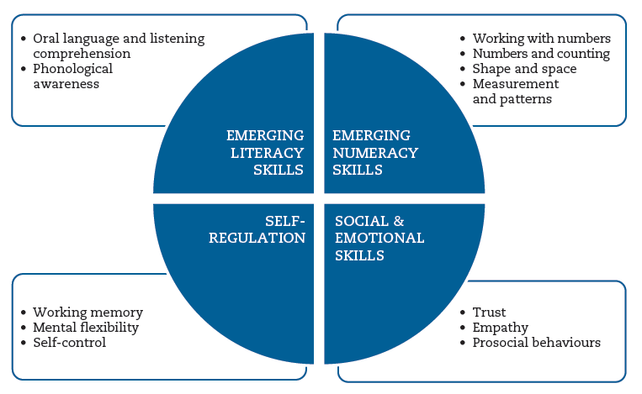
International Early Learning and Child Well-being Study

Slide 23
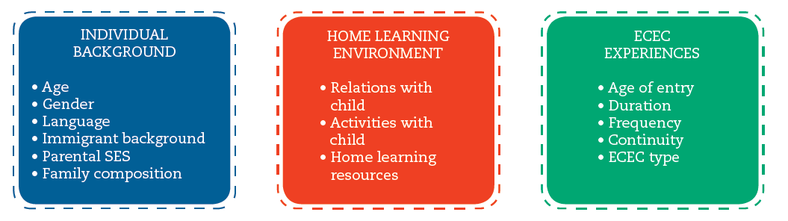
International Early Learning and Child Well-being Study
Learning Context

Slide 24
Measuring adult skills

Slide 25


Numeracy proficiency levels

Slide 26
Labour productivity and the use of reading skills at work
Notes:
This slide shows the positive relationship between labour productivity (GDP per hour worked) at the country level and the average intensity of the use of reading skills at work. This relationship holds even when controls are added for literacy proficiency.
This relationship will to a degree reflect the industrial and occupational structure of the countries concerned.

Slide 27

Digital problem-solving skills (PIAAC)
Young adults (16-24 year-olds)
Older adults (55-65 year-olds)

Slide 28
Some methodological challenges
Can we sufficiently distinguish the role of context from that of the underlying cognitive construct ?
Do new types of items that are enabled by computers and networks change the constructs that are being measured ?
Can we drink from the firehose of increasing data streams that arise from new assessment modes ?
Can we utilise new technologies and new ways of thinking of assessments to gain more information from the classroom without overwhelming the classroom with more assessments ?
What is the right mix of crowd wisdom and traditional validity information ?
How can we create assessments that are activators of students’ own learning ?
Notes:
There are some tough methodological challenges that need to be addressed:
Can we sufficiently distinguish the role of context from that of the underlying cognitive construct ?
Do new types of items that are enabled by computers and networks change the constructs that are being measured ?
Can we drink from the firehose of increasing data streams that arise from new assessment modes ?
Can we utilise new technologies and new ways of thinking of assessments to gain more information from the classroom without overwhelming the classroom with more assessments ?
What is the right mix of crowd wisdom and traditional validity information ?
How can we create assessments that are activators of students’ own learning ?

Slide 29

Thank you
  Find out more about our work at www.oecd.org/pisa
    All publications
    The complete micro-level database
  Email: Andreas.Schleicher@OECD.org
  Twitter: SchleicherOECD
  Wechat: AndreasSchleicher
  and remember:
  Without data, you are just another person with an opinion

