Slide 1
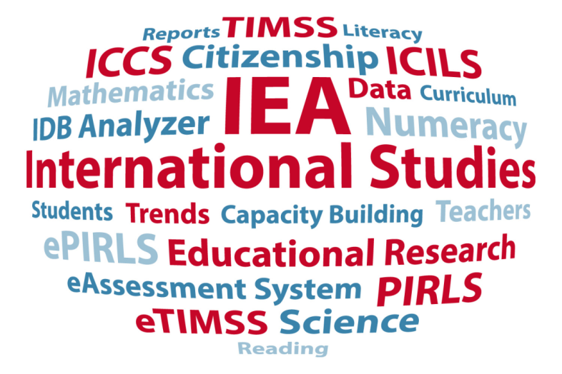
International Large-Scale Assessments – Best practice and what are they good for?
Dirk Hastedt, IEA
Moscow, October 2015

Slide 2
Overview
Historical overview
Current IEA studies
Some selected results
Limitations

Slide 3
Historical overview

Slide 4
First considerations
In 1958 educational researchers from various disciplines (educational psychologists, sociologists, and psychometricians) met at the UNESCO Institute for Education in Hamburg, Germany
They discussed how to evaluate educational systems
They argued that both input and output must be examined
Output was defined as achieved knowledge but also as attitudes and participation in education

Slide 5
First considerations
The idea was to learn from each other by means of international studies
The term “The world as an educational laboratory” was coined
“If custom and law define what is educationally allowable within a nation, the educational systems beyond one's national boundaries suggest what is educationally possible.” Arthur W. Foshay

Slide 6
IEA
Non-governmental research organization
Independent, international cooperative of national research institutions and governmental research agencies
Founded in 1958, more than 30 research studies of cross-national achievement
Large-scale comparative studies of educational achievement and other aspects of education
More than 60 member country institutions, nearly 100 participating countries in IEA studies

Slide 7
Current IEA studies

Slide 8
IEA TIMSS
Trends in International Mathematics and Science Study
Assesses the mathematics and science achievement and competencies of grade 4, grade 8, and grade 12 students (grade-based assessment)
Conducted every four years since 1995 in up to 70 countries
From 2019 on offered also electronically

Slide 9
IEA TIMSS
TIMSS is curriculum-based
Based on the model “intended, implemented, and achieved curriculum”
Assessment of intact classes
Questionnaires for students, teachers, principals, parents, and countries
Conducted by an international research consortium directed by the Study Center at Boston College
Assisted by groups of experts in the field to develop framework and instruments (e.g. Galina Kovaleva from the Russian Academy of Education, Vitaly Gribov from the Moscow Lomonosov State University)

Slide 10
IEA PIRLS
Progress in International Reading Literacy Study
Assesses reading ability of 4th-graders (at the time of moving from „Learning to Read“ to „Reading to Learn“) of literary and informational text on paper and electronically
Conducted every five years since 2001 in more than 60 countries

Slide 11
IEA PIRLS
PIRLS is curriculum-based
Based on the model „intended, implemented, and achieved curriculum“
Assessment of intact classes
Questionnaires for students, teachers, principals, parents, and countries
Conducted by an international research consortium directed by the Study Center at Boston College
Assisted by groups of experts in the field to develop framework and instruments (e.g. Galina Zuckerman from the Russian Academy of Education)

Slide 12
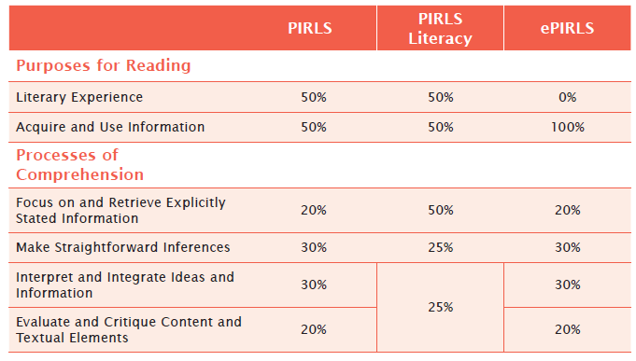
PIRLS 2016

Slide 13
IEA ICCS
International Civic and Citizenship Education Study
Investigates the knowledge and understanding of civics and citizenship of 8th-graders
The second cycle is currently being conducted

Slide 14
IEA ICILS
International Computer and Information Literacy Study
Assessed computer literacy competencies of grade 8 students
Receptive and productive competencies
Conducted in 21 educational systems

Slide 15
Participation of the Russian Federation
Russia participated in all cycles of TIMSS since the beginning in 1995
Russia participated in all cycles of PIRLS since the beginning in 2001
Russia also participated in TEDS-M, ICILS, ICCS 2009 and 2016
Russia is one of the most active members in International Large Scale Assessments and in IEA studies in particular

Slide 16
Selected results

Slide 17
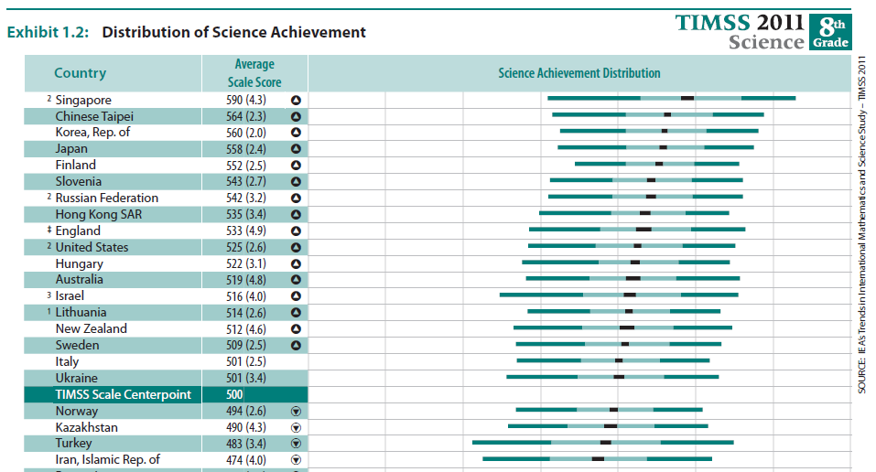
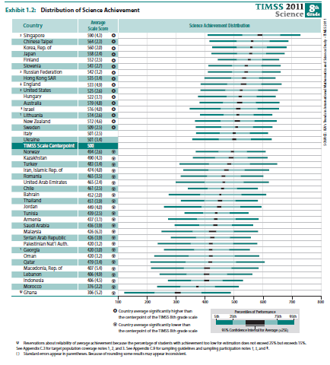
TIMSS grade 8 science results

Slide 18
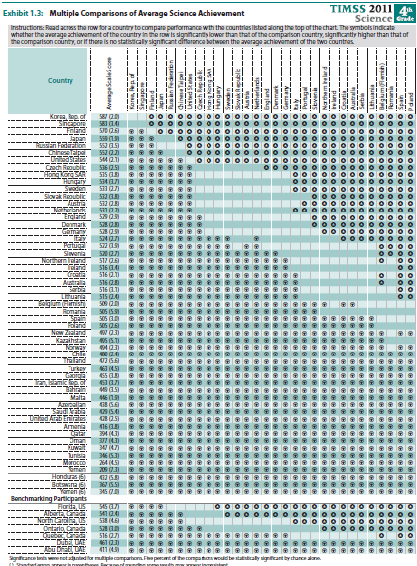
TIMSS grade 4 science results

Slide 19
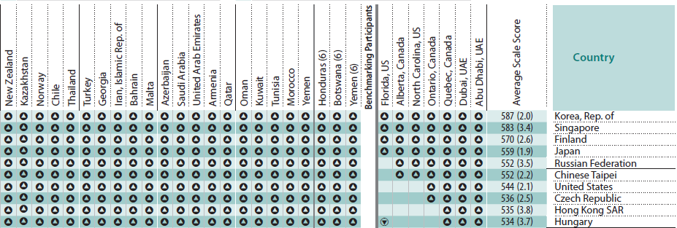
TIMSS grade 4 science results
Russia is doing not as good as Korea, Singapore, or Finland
Russia is not different from Japan or Taiwan
Russia is doing better than the other 47 countries

Slide 20
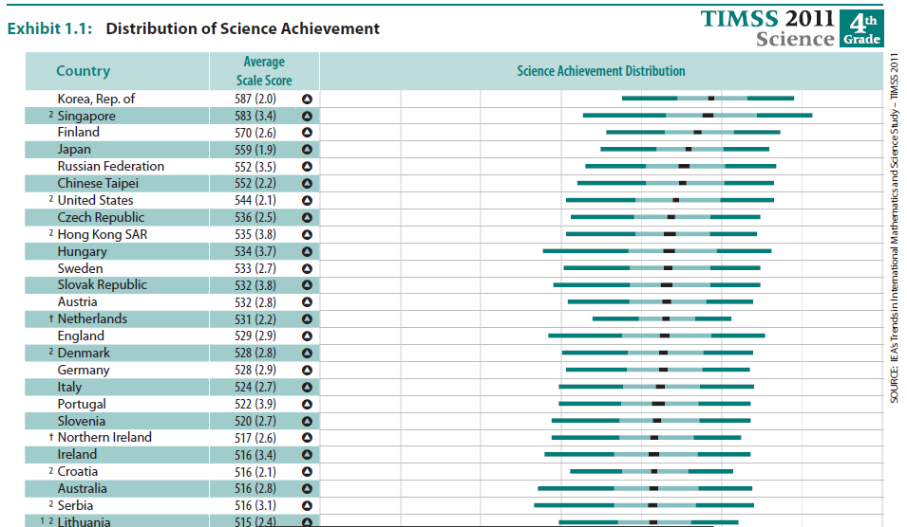
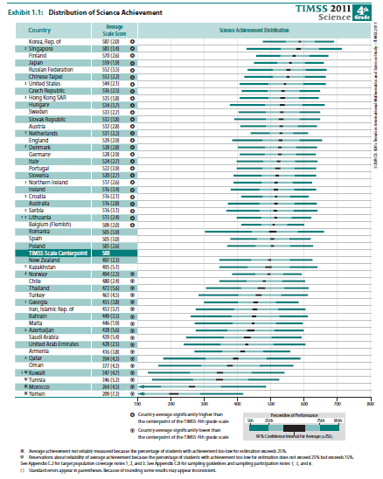
TIMSS grade 4 science results

Slide 21
TIMSS grade 4 mathematics results
21

Slide 22
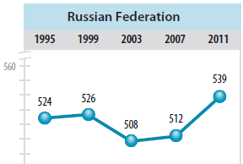
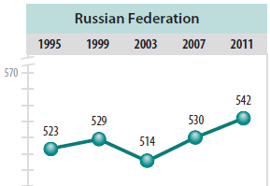
TIMSS trends

Slide 23
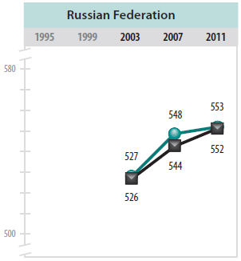
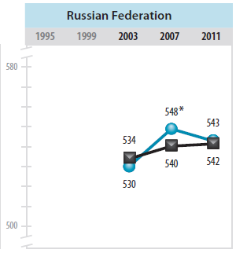
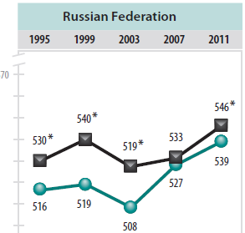
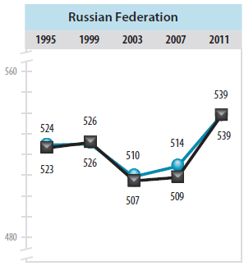
TIMSS trends by gender

Slide 24
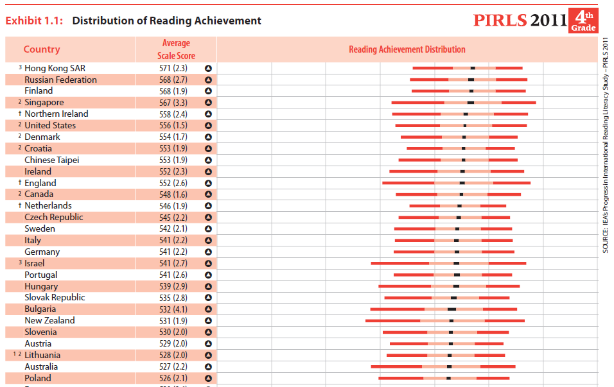
PIRLS results

Slide 25
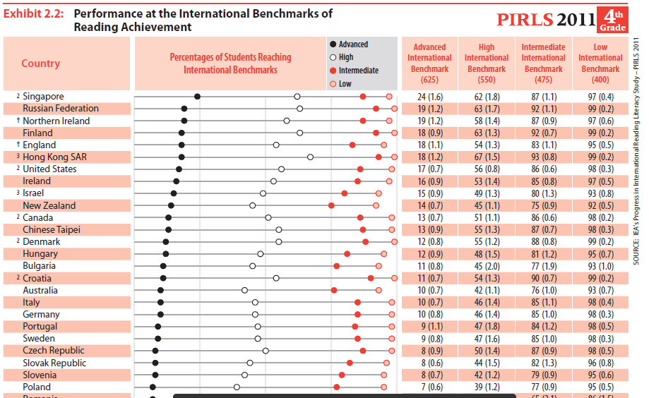
PIRLS benchmark results

Slide 26
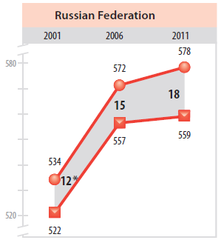
PIRLS trends

Slide 27
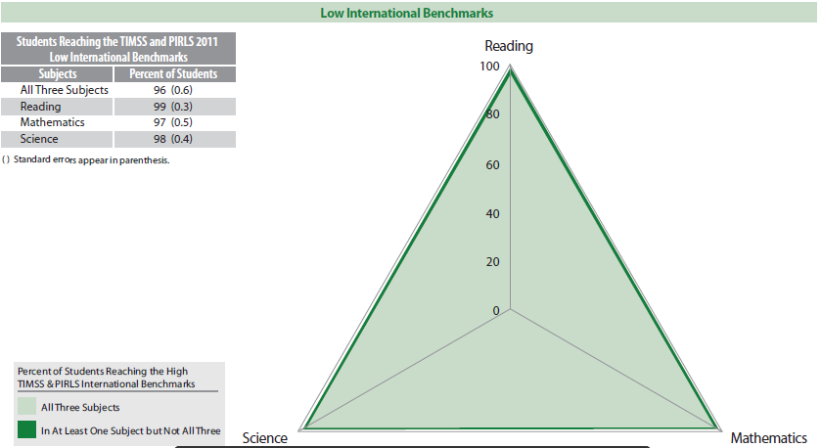
TIMSS – PIRLS results

Slide 28
TIMSS – PIRLS results

Slide 29
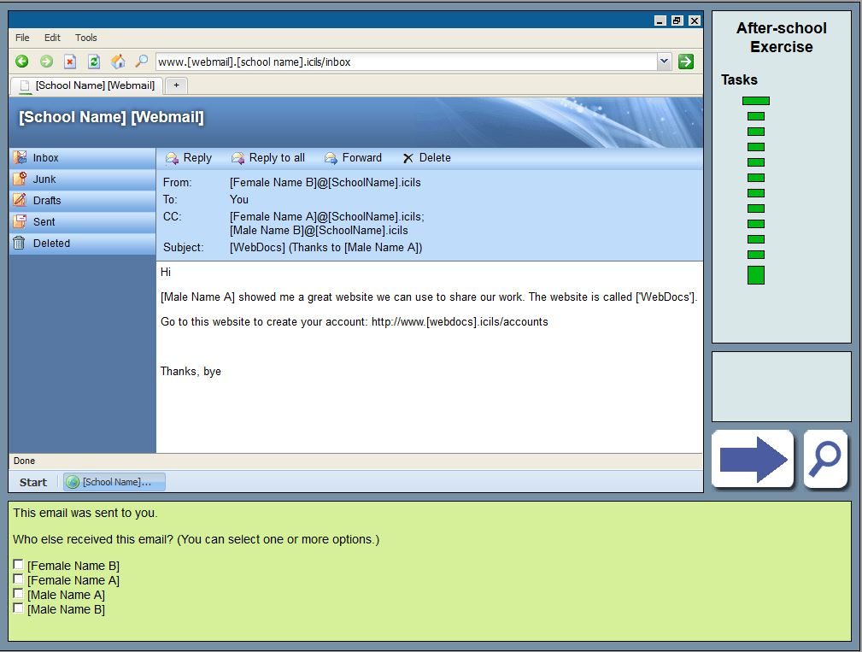
Example of an ICILS test item – task proficiency level 1

Slide 30
ICILS - Percentage correct

Slide 31
ICILS - Proficiency levels
Notes:
We find as little as 2% below level 1 in the Czech Republic but also more than 60% below level 1 in Thailand and Turkey. On average 17% of the students didn’t reach level 1. On average only 2% of the students reached level 4 with a maximum of 5% in Korea.

Slide 32
Learning ICT in schools
Notes:
But where do the students acquire their knowledge of computers and ICT literacy?
Here we found large differences. In Australia digital literacy skills are taught more extensively whereas in Germany or Korea this is taught less.

Slide 33
Students’ average of learning ICT tasks in school
Country | Teachers’ ICT self-efficacy | Teachers’ Positive views of ICT | Teachers’ Collaboration about ICT use | Lack of ICT resources in school
Australia | 0.20 | 0.17 | 0.19 | 0.02
Chile | 0.32 | 0.14 | 0.16 | 0.01
Croatia | 0.43 | 0.18 | 0.12 | -0.05
Czech Republic | 0.31 | 0.12 | 0.16 | 0.00
Korea, Rep. of | 0.33 | 0.29 | 0.16 | -0.01
Lithuania | 0.32 | 0.06 | 0.16 | -0.06
Poland | 0.36 | 0.02 | 0.33 | -0.06
Russian Federation | 0.33 | 0.06 | 0.22 | -0.09
Slovak Republic | 0.36 | 0.11 | 0.20 | -0.03
Slovenia | 0.29 | 0.17 | 0.19 | -0.03
Thailand | 0.34 | 0.13 | 0.21 | -0.05
Turkey | 0.28 | 0.15 | 0.23 | -0.21
ICILS 2013 average | 0.32 | 0.13 | 0.19 | -0.05
Notes:
This requires not only computers being available in schools - which is already a given in most countries.
But it requires also the expertise of teachers and their willingness to use them.

Slide 34
Teachers’ confidence in using ICT
Country | All Teachers |  | Under 40 |  | 40 and over |  | Difference
Australia | 55 | (0.2) | 57 | (0.2) | 53 | (0.3) | -4 | (0.3)
Chile | 52 | (0.4) | 55 | (0.3) | 48 | (0.6) | -7 | (0.7)
Croatia | 47 | (0.3) | 52 | (0.4) | 43 | (0.4) | -8 | (0.6)
Czech Republic | 50 | (0.3) | 53 | (0.3) | 47 | (0.3) | -6 | (0.4)
Korea, Rep. of | 53 | (0.3) | 55 | (0.3) | 52 | (0.5) | -4 | (0.6)
Lithuania | 50 | (0.3) | 55 | (0.5) | 48 | (0.3) | -6 | (0.7)
Poland | 51 | (0.3) | 54 | (0.4) | 50 | (0.4) | -5 | (0.5)
Russian Federation | 49 | (0.4) | 52 | (0.5) | 48 | (0.4) | -4 | (0.5)
Slovak Republic | 50 | (0.2) | 53 | (0.3) | 47 | (0.3) | -6 | (0.4)
Slovenia | 50 | (0.3) | 54 | (0.5) | 47 | (0.3) | -7 | (0.5)
Thailand | 45 | (0.6) | 48 | (0.6) | 42 | (0.8) | -7 | (0.7)
Turkey | 49 | (0.5) | 50 | (0.5) | 45 | (1.0) | -5 | (1.0)
ICILS 2013 average | 50 | (0.1) | 53 | (0.1) | 47 | (0.1) | -6 | (0.2)
Notes:
The biggest obstacle – as reported by ICT coordinators in school - but also by the teachers themselves – are the teachers.
Some teachers don’t feel very comfortable using ICT and teaching the use of ICT.
Mostly older teachers have less confidence in using ICT.
For example in-service training on ICT for teachers could be a driver for improving the students’ ICT literacy skills!

Slide 35
Limitations

Slide 36
Limitations
All current international large-scale assessments have a cross-sectional design
Some – like TIMSS – are pseudo-longitudinal
They have no experimental design
This means…

Slide 37
Limitations
Causal inferences cannot be drawn
We cannot state, for example:
Better equipped schools produce better educated students.
More homework has a positive effect on the students’ achievement.
The differences between boys and girls in science is caused by the boys’ greater interest in the subject.

Slide 38
Limitations
We also cannot make any claims about consequences of changes
For example, we cannot state:
If science teachers get more professional training this would lead to an increase of their students’ achievement by 10 score points.
To close the gender gap in reading performance policy makers need to promote boys’ attitudes towards reading.

Slide 39
Limitations
Another problem arising is the focus on rankings
If the rankings in international large-scale assessments are increasingly coming into focus and – as a consequence – if they are becoming a high-stakes assessment at country level, then the same negative impacts as caused by other high-stakes assessments can occur
We found, for example, that some countries changed the curriculum with more emphasis on mathematics and science on the expenses of social science and other subjects

Slide 40
So, what can we do…?
Make sure that
the data is used - and used wisely
the results are not over interpreted
the studies have a broad focus
the focus is on real outcomes rather than on rankings

Slide 41
Thank you for your attention!
Спасибо за внимание!
Questions?
Вопросы?

