Slide 1

PISA
Evaluating education
to improve learning
PISA seeks to help…
… students to learn better
… teachers to teach better
… school systems to become
more effective
Moscow
30 September 2016
Andreas Schleicher
Notes:
I want to start with a brief overview of the objectives and origins of PISA, then show you where the US stands and what the most effective school systems show can be achieved, and conclude with what all of this means for education policy.
I need to remind you that the material remains under embargo until next Tuesday.

Slide 2
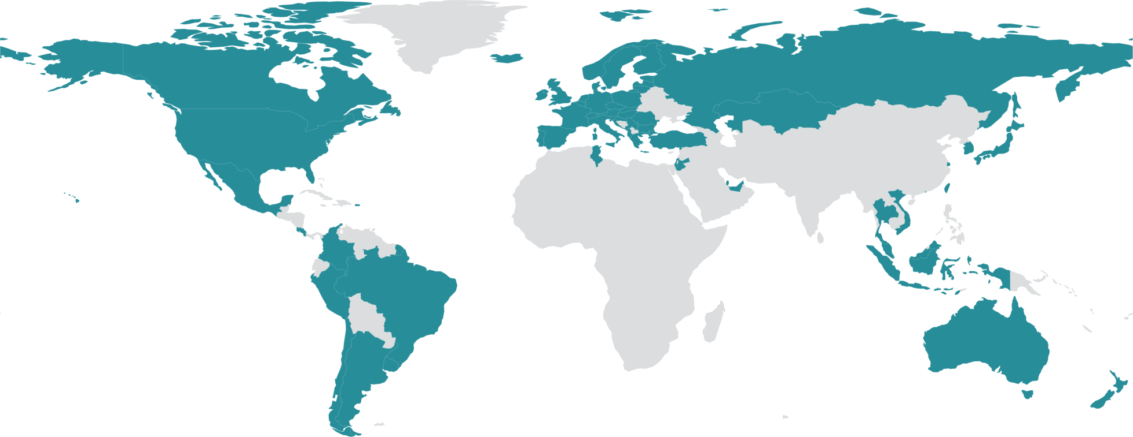
PISA in brief
Over half a million students…
  representing 40 million 15-year-olds in over 80 countries/economies
… take an internationally agreed test each three years…
  Goes beyond testing whether students can
  reproduce what they were taught…
  … to assess students’ capacity to extrapolate from what they know and creatively apply their knowledge in novel situations
  Mathematics, reading, science, problem-solving,
  Global competencies, social and emotional competencies
… and respond to questions on…
  their personal background, their schools
  and their engagement with learning and school
Parents, teachers, principals and system leaders provide data on…
  school policies, practices, resources and institutional factors that help explain performance differences .

Slide 3
PISA in brief
Key principles
  ‘Crowd sourcing’ and collaboration
    PISA draws together leading expertise and institutions from participating countries to develop instruments and methodologies…
    … guided by governments on the basis of shared policy interests
  Cross-national relevance and transferability of policy experiences
    Emphasis on validity across cultures, languages and systems
    Frameworks built on well-structured conceptual understanding
    of academic disciplines and contextual factors
  Triangulation across different stakeholder perspectives
    Systematic integration of insights from students, parents, teachers
    school principals and system-leaders
  Advanced methods with different grain sizes
    A range of methods to adequately measure constructs with different grain sizes to serve different decision-making needs
    Productive feedback, at appropriate levels of detail, to fuel improvement at every level of the system .

Slide 4

Mathematics in PISA
The real world
The mathematical World
Making the problem amenable to mathematical treatment
A model of reality
A mathematical
model
Understanding, structuring and simplifying the situation
Using relevant mathematical tools to solve the problem
A real situation
Validating
the results
Real results
Mathematical
results
Interpreting
the mathematical results
Notes:
I want to stress here that those generic competencies do not stand in contrast to subject matter skills. But we should reflect on how we teach those subject matter skills. After all, mathematics is just a language with which to describe and understand the world, and the same is true for history, just with different paradigms. What you want to achieve is to ensure that students understand those paradigms rather than being trapped by their mere instantiations.
Here is how we deal with that in PISA.

Slide 5

High mathematics performance
… Shanghai-China performs above this line (613)
Average performance
of 15-year-olds in
Mathematics (PISA)
Fig I.2.13
Low mathematics performance
Notes:
This chart illustrates the reading literacy scale, from below the OECD average, marked in red, to around the OECD average, marked in yellow, to high performance, marked in green.
.

Slide 6
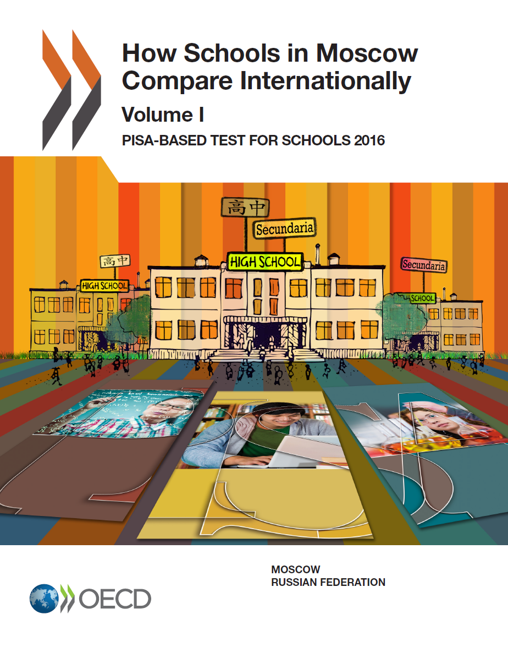

Результаты в области математической грамотности
в школах Москвы и Российской Федерации
136 баллов
разница
Russian Federation
Average
Russian Federation
Average
1.06 разница
ЭСКС

Slide 7
Результаты учащихся по математической грамотности в школах Москвы и Российской Федерации
Moscow
Top 100 Moscow Schools
Districts
Russian Federation
(PISA 2012)

Slide 8
Результаты учащихся московских школ и
сравниваемых стран
Moscow reading
Other reading
(PISA 2012)
Moscow mathematics
Other mathe-
Matics
(PISA 2012)
Moscow science
Other science
(PISA 2012)
197 points
difference
285 points
difference
180 points
difference

Slide 9
Уровни математической грамотности учащихся в Москве и сравниваемых странах
(PISA 2012) | Шанхай (Китай)
 | США
 | Российская Федерация
 | Москва
 | ТОП-100 Москвы

Slide 10
High mathematics performance
Average performance
of 15-year-olds in
mathematics
Strong socio-economic
impact on student
performance
Socially equitable
distribution of learning
opportunities
Low mathematics performance
Notes:
But I do want to introduce a second dimension into this picture, that PISA pays great attention to. When you look at the distribution of student performance within each country, there are some countries in which social background has a strong impact on student performance, in other words, where educational opportunities are very unequally distributed, where there is a large gap between winners and losers and where a lot of the potential that children bring with them is wasted. There are other countries, where it matters much less into which social context students are born, where outcomes are socially equitably distributed.
If you look at this, it is clear where we all want to be, namely where performance and equity are both strong. And nobody, and no country, can accept to be where performance is low and opportunities are very unequally distributed. Whether it is better to have high performance at the price of large disparities, or better to invest in small disparities at the price of mediocracy, that is subject to debate.

Slide 11
High mathematics performance
2012
Strong socio-economic
impact on student
performance
Socially equitable
distribution of learning
opportunities
Low mathematics performance
Notes:
Strength of ESCS on performance (% variance explained) and maths perf 2012

Slide 12
High mathematics performance
2012
Strong socio-economic
impact on student
performance
Socially equitable
distribution of learning
opportunities
Low mathematics performance
Notes:
Strength of ESCS on performance (% variance explained) and maths perf 2012

Slide 13
High mathematics performance
Strong socio-economic
impact on student
performance
Socially equitable
distribution of learning
opportunities
Low mathematics performance
Notes:
Strength of ESCS on performance (% variance explained) and maths performance 2012
Size of bubbles shows spending levels

Slide 14
Contribution of various factors to upper secondary teacher compensation costs, per student as a percentage of GDP per capita (2004)
Percentage points
Notes:
The red dot indicates classroom spending per student, relative to the spending capacity of countries, the higher the dot, the more of its GDP a country invests.
High salaries are an obvious cost driver. You see Korea paying their teachers very well, the green bar goes up a lot. Korea also has long school days, another cost driver, marked here by the white bar going up. Last but not least, Korea provides their teachers with lots of time for other things than teaching such as teacher collaboration and professional development, which costs money as well. So how does Korea finances all of this? They do this with large classes, the blue bar pulls costs down.
If you go to the next country on the list, Luxembourg, you see that the red dot is about where it is for Korea, so Luxembourg spends roughly the same per student as Korea. But parents and teachers in Luxembourg mainly care about small classes, so policy makers have invested mainly into reducing class size, you see the blue bar as the main cost driver. But even Luxembourg can only spend its money once, and the result is that school days are short, teacher salaries are average at best and teachers have little time for anything else than teaching. Finland and the US are a similar contrast.
Countries make quite different spending choices. But when you look at this these data long enough, you see that many of the high performing education systems tend to prioritise the quality of teachers over the size of classes.

Slide 15
High mathematics performance
Strong socio-economic
impact on student
performance
Socially equitable
distribution of learning
opportunities
Low mathematics performance
Notes:
Strength of ESCS on performance (% variance explained) and maths performance 2012
Size of bubbles shows spending levels

Slide 16
Shanghai
High mathematics performance
2003 - 2012
Germany, Turkey and Mexico improved both their mathematics performance and equity levels
Singapore
Liechtenstein, Norway, the United States and Switzerland improved their equity levels (no change in performance)
Singapore
Brazil, Italy, Macao-China, Poland, Portugal, Russian Federation, Thailand and Tunisia improved their mathematics performance (no change in equity)
Strong socio-economic
impact on student
performance
Socially equitable
distribution of learning
opportunities
Turkey 2003
Chile 2003
Low mathematics performance
Notes:
Lots of people still dismiss these results by saying these differences are all about culture. But if that was true, you would see the same picture year after year, and that’s not the case.

Slide 17
  High impact on outcomes
Must haves
Quick wins
Can we make it happen?
It’s everybody’s business
Low feasibility
High feasibility
Money pits
Low hanging fruits
Low impact on outcomes

Slide 18
  High impact on outcomes
Must haves
Quick wins
Commitment to universal achievement
Capacity
at point of delivery
Resources
where they yield most
Gateways, instructional systems
Coherence
A learning system
Low feasibility
High feasibility
Incentive structures and accountability
Money pits
Low hanging fruits
Low impact on outcomes

Slide 19
The ‘big’ objectives
Understanding what the assessment reveals about students’ thinking to shape better opportunities for student learning
Responding to assessments can enhance student learning if tasks are well crafted to incorporate principles of learning
Capitalise on improved data handling tools and technology connectivity to combine formative and summative assessment interpretations for a more complete picture of student learning
Multi-layered, coherent assessment systems from classrooms to schools to regional to national to international levels that…
  Support improvement of learning at all levels of the education system
  Are largely performance-based
  Make students’ thinking visible and allow for divergent thinking
  Are adaptable and responsive to new developments
  Add value for teaching and learning by providing information that can be acted on by students, teachers, and administrators (digital delivery of PISA)
  Are part of a comprehensive and well-aligned continuum, communicate what is expected and hold relevant stakeholders accountable .
Integrate, synthesize and creatively apply content knowledge in novel situations
Activate students as owners of their own learning and activate students as learning resources for one another
Notes:
But there are also some common trends, most importantly the move towards multi-layered assessment systems that coherently extend from students to schools to states, nations and the international level.
These assessments seek not to take learning time away from students, but try to enhance the learning of students, of teachers, of school administrators and policy makers, through building frameworks for lateral accountability.
The assessments underline that successful learning is as much about the process as it is about facts and figures, they emphasise that success is not about the reproduction of subject matter content, but about the capacity to integrate, synthesize and creatively extrapolate from what you know and apply that knowledge in novel situations.
They try to provide a window into students’ understandings and the conceptual strategies a student uses to solve a problem.
They provide dynamic task contexts in which prior actions may stimulate unpredictable reactions that in turn influence subsequent strategies and options.
They try to add value for teaching and learning. The process of responding to assessments can
enhance student learning if assessment tasks are well crafted to incorporate principles of learning and cognition. For example, assessment tasks can incorporate transfer and authentic applications, and can provide opportunities for students to organize and deepen their understanding through explanation and use of multiple representations. They try to generate information that can be acted upon and provides productive and usable feedback for all intended users. Teachers need to be able to understand what the
assessment reveals about students’ thinking. And school administrators, policymakers, and teachers need to be able to use this assessment information to determine how to create better opportunities for student learning.
Last but not least, those assessments do not operate in a vacuum but, are part of a comprehensive set of instruments that extend to instructional material as well as teacher training.

Slide 20

20
Thank you
  Find out more about our work at www.oecd.org
    All publications
    The complete micro-level database
  Email: Andreas.Schleicher@OECD.org
  Twitter: SchleicherEDU
  and remember:
  Without data, you are just another person with an opinion

